Slide 1
STANDARD OF CARE
Systematic review and consensus: unilateral cochlear implants for bilateral severe, profound, or moderate sloping to profound sensorineural hearing loss¹
Consensus statements for cochlear implantation
Category 7 - Cost implications of CIs
¹Delphi Consensus Group on Cochlear Implantation in Adults; Craig A Buchman, René H Gifford, David Haynes, Thomas Lenarz, Gerard O’Donoghue, Oliver Adunka, Allison Biever, Robert Briggs, Matthew L Carlson, Pu Dai, Colin Driscoll, Howard W Francis, Bruce Gantz, Richard K Gurgel, Marlan Hansen, Meredith Holcomb, Eva Karltorp, Milind Kirtane, Jannine Larky, Emmanuel Mylanus, J Thomas Roland Jr, Shakeel R Saeed, Henryk Skarzynski, Piotr H Skarzynski, Mark Syms, Holly Teagle, Paul Van de Heyning, Christophe Vincent, Hao Wu, Tatsuya Yamasoba, Terry Zwolan.

Slide 2
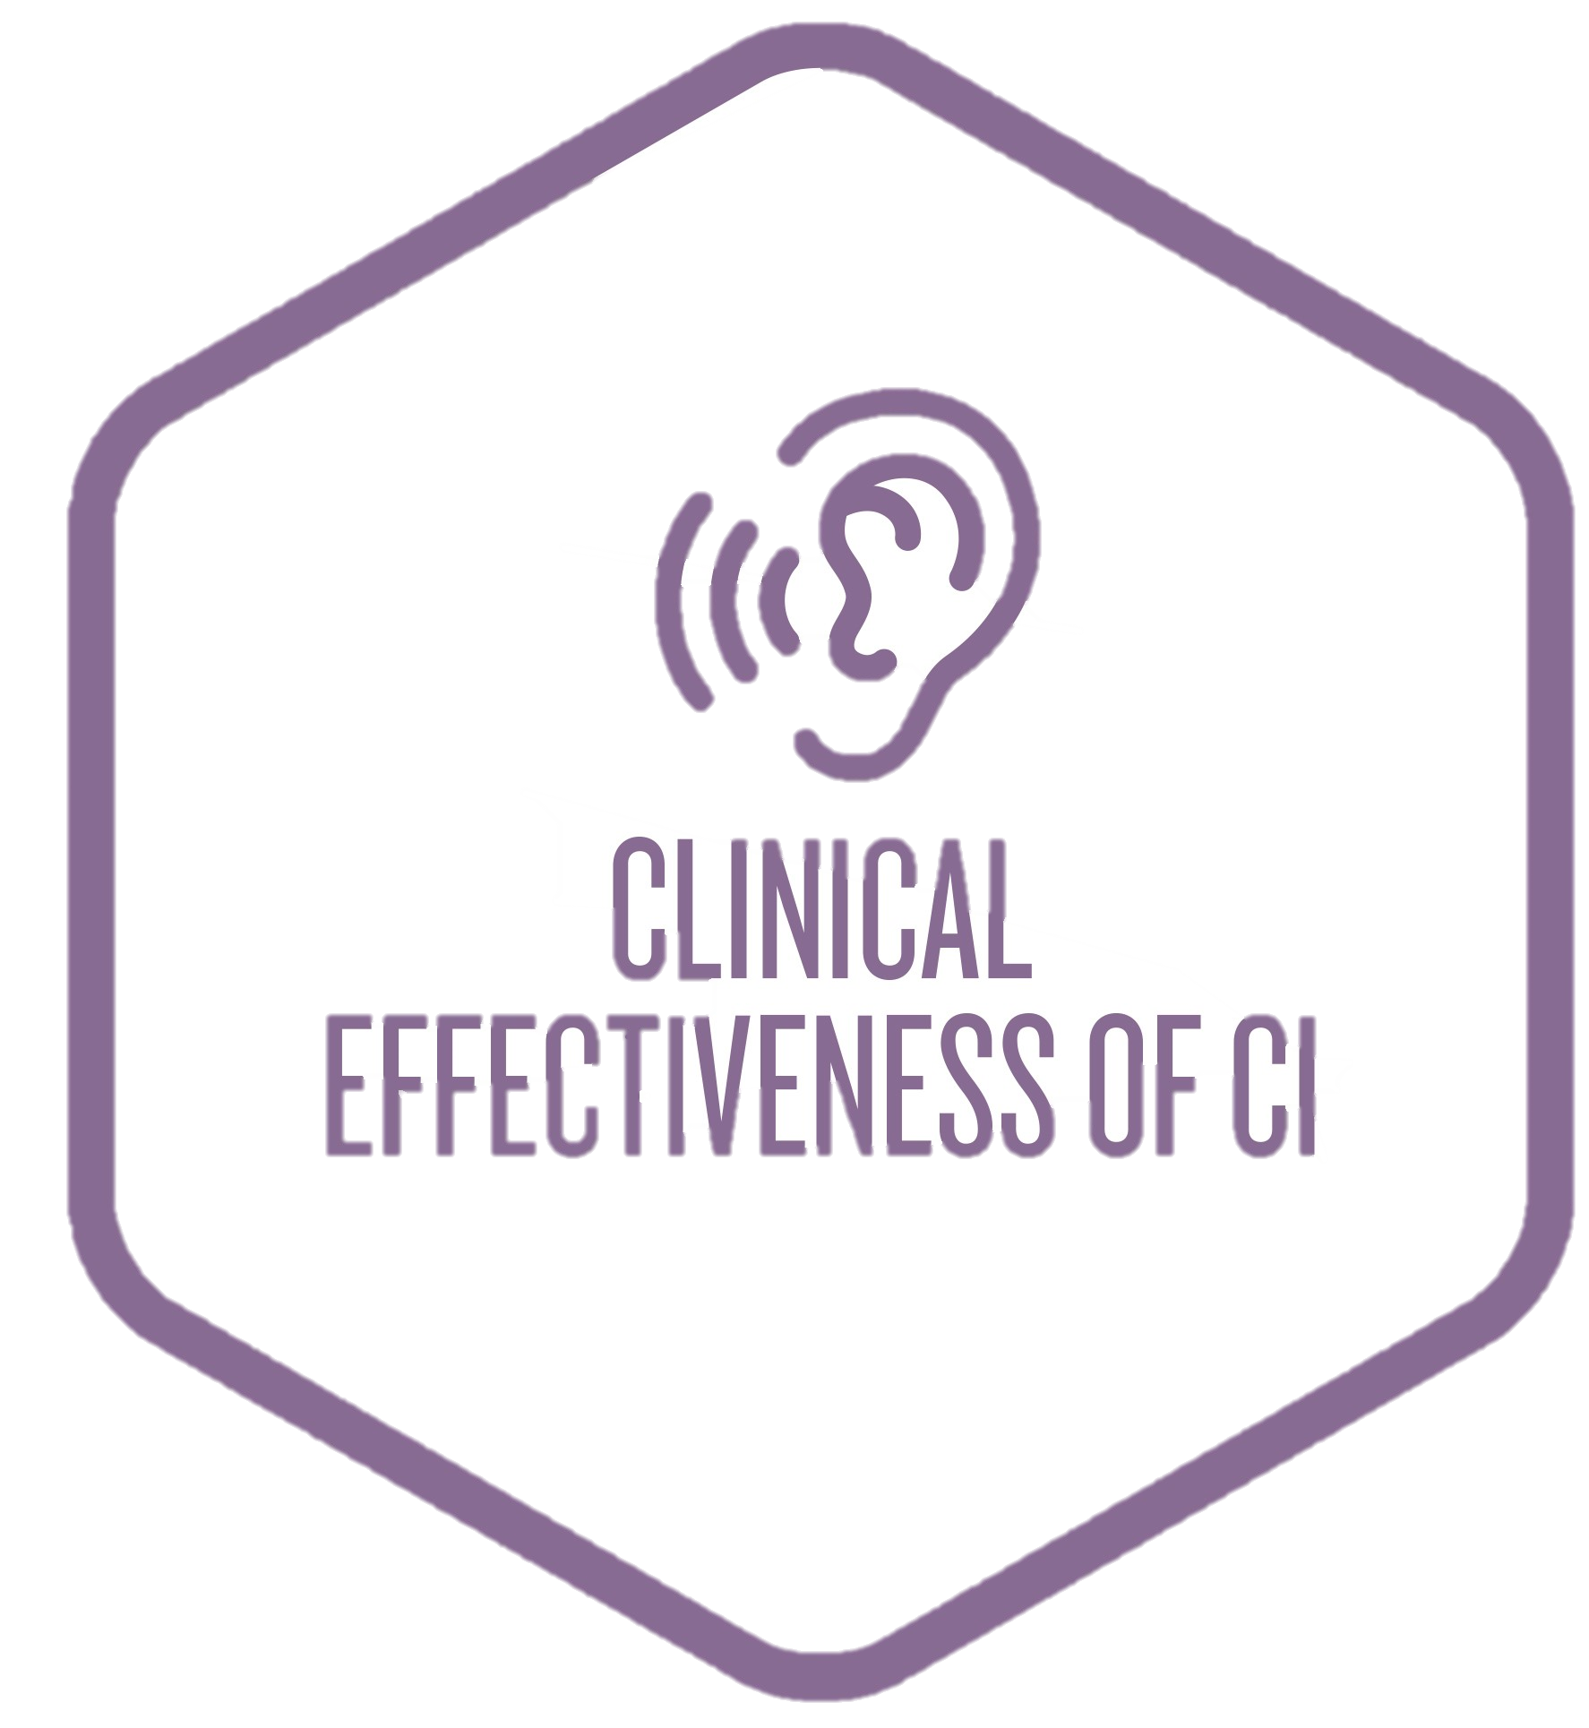
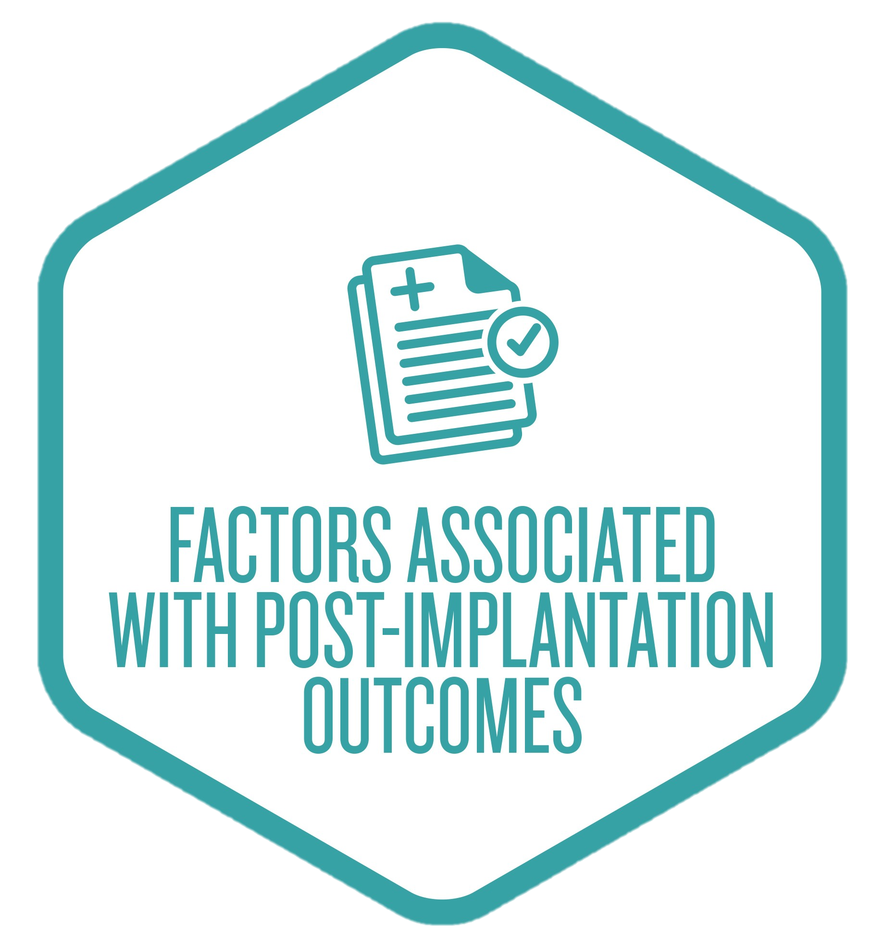
Consensus Statement Categories
Level of awareness of CIs
Best practice clinical pathway for diagnosis
Best practice guidelines for surgery
Clinical effectiveness of CIs
Factors associated with post-implantation outcomes
The relationship between hearing loss and depression, cognition and dementia
Cost implications of CIs

Slide 3
Consensus Statement
20. Unilateral cochlear implantation in adults is cost-effective when compared with no implant or no intervention at all and is associated with increased employment and income.¹
¹Delphi Consensus Group on Cochlear Implantation in Adults.

Slide 4
Findings What did the systematic literature review tell us?

Slide 5
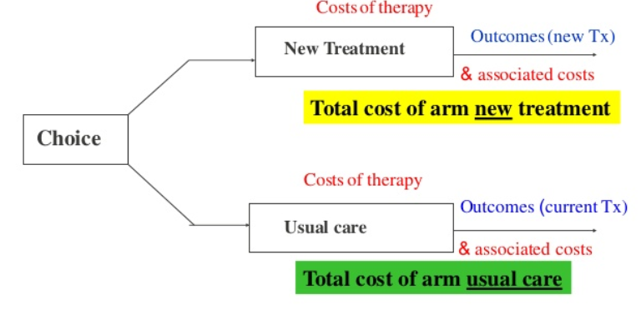
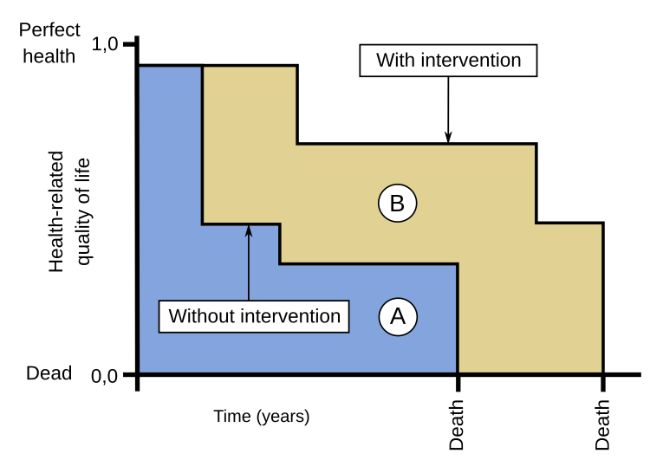
What is Quality-Adjusted-Life-Years (QALY)?
Approach for estimating quality of life benefits in economic evaluations
Health is measured in utilities
0 = Death
1 = Perfect health
The amount of time an individual spends in a given health state is then multiplied by the health state preference value to calculate the Quality Adjusted Life Years (QALY)s gained
1 QALY = 1 year of life in perfect health
Example; Quality of life: Significant improvements were reported post CI, in ability to communicate, self esteem, activities and social functioning
Klop WM, Boermans PP, Ferrier MB, Van Den Hout WB, Stiggelbout AM, Frijns JHM. Clinical relevance of quality of life outcome in cochlear implantation in postlingually deafened adults. Otol Neurotol 2008
Notes:
The most widely used approach for estimating quality of life benefits in economic evaluations is the QALY. In this approach, states of health are assigned a health state preference or 'utility' value, on a scale including 1.0 (full health) and 0 (death). The amount of time an individual spends in a given health state is then multiplied by the health state preference value to calculate the QALYs gained.
Quality of life: Significant improvements were reported post CI, in ability to communicate, self esteem, activities and social functioning. ⁶⁴

Slide 6
Statement 20: Unilateral cochlear implantation in adults is cost-effective when compared with no implant or no intervention at all and is associated with increased employment and income.
2 studies reported the incremental cost-effectiveness ratios for unilateral implants versus no implant or no intervention.*,**
Increments ranged from:
£11,440 to £17,625 (i.e. US$27,250 - 41,983 at 2017 prices) per QALY in the UK healthcare system†
€17,100 to €22,500 (i.e. US$25,190 - 33,144 at 2017 prices) per QALY in a Dutch study*
1 study demonstrated both an increase in employment rate and median income following unilateral CI in adults.
*QALY: Quality of life years *Klop WM, Boermans PP, Ferrier MB, Van Den Hout WB, Stiggelbout AM, Frijns JHM. Clinical relevance of quality of life outcome in cochlear implantation in postlingually deafened adults. Otol Neurotol 2008
**Bond M, Mealing S, Anderson R, Elston J, Weiner G, Taylor RS, et al. The effectiveness and cost-effectiveness of cochlear implants for severe to profound deafness in children and adults: a systematic review and economic model. Health Technol Assess 2009.
† Monteiro E, Shipp D, Chen J, Nedzelski J, Lin V. Cochlear implantation: a personal and societal economic perspective examining the effects of cochlear implantation on personal income. J Otolaryngol Head Neck Surg 2012.
Notes:
One study reported that, based on the common willingness-to-pay threshold of £30,000 per QALY*, unilateral CIs are cost-effective.⁹⁹
Two studies reported the incremental cost-effectiveness ratios for unilateral implants versus no implant or no intervention,^{64, 99} which ranged from £11,440 (US$27,250 at 2017 prices) to £17,625 (US$41,983 at 2017 prices) per QALY in the UK healthcare system⁹⁹ and from €17,100 (US$25,190 at 2017 prices) to €22,500 (US$33,144 at 2017 prices) per QALY in a Dutch study.⁶⁴
Another study demonstrated both an increase in employment rate and an increase in median income following unilateral cochlear implantation in adults.¹⁰⁰

Slide 7
Supporting Evidence: Klop et al 2008
Objective:
1⁰ -Evaluate Quality of life (QoL) benefits after CI (HUI2 and NCIQ)
2⁰ -Describe the clinical relevance of cochlear implantation in Health related Quality of life (HRQoL) items using effect size (ES) and minimal clinically important difference (MID)
Method: Prospective intervention study in 3⁰ referral hospital. N=44 CI-adults with > 12 months CI-experience. Scores for speech recognition and quality of life measured and compared at preimplant (HAs) and post-implant (CI). Correlations with patient factors were examined.
Measures used: at preimplant and postimplant intervals 2¹, 4², 12 and 24¹ months
Dutch CVC word lists
Health Utility Index Mark II (HUI2)
Time trade-off scores (TTO)
Nijmegen Cochlear Implant Questionnaire (NCIQ)
Klop WM, Boermans PP, Ferrier MB, Van Den Hout WB, Stiggelbout AM, Frijns JHM. Clinical relevance of quality of life outcome in cochlear implantation in postlingually deafened adults. Otol Neurotol 2008
Notes:
1 – speech tests only at this interval, 2- HRQL measures only at this this interval

Slide 8
Supporting Evidence: Klop et al 2008
Results: Post-implant, significant improvements in group scores (p<0.001) compared to preimplant for:
CI is associated with a significant increase in health utility measured by HUI2 and time trade-off (TTO)
Educational level, age at implant and duration of loss correlated with one or more outcome measures
Large effect
Medium effect
small effect
No effect
Graph sourced from data on estimations of clinical relevance. Size represents MID %
Conclusion: Patients had significant improvements in hearing and communication, self-esteem, daily activities, and social functioning. Statistically significant improvements were also clinically relevant (via MID and ES). Important predictors of outcomes are, duration of deafness and educational level.
Klop WM, Boermans PP, Ferrier MB, Van Den Hout WB, Stiggelbout AM, Frijns JHM. Clinical relevance of quality of life outcome in cochlear implantation in postlingually deafened adults. Otol Neurotol 2008
Notes:
Results: Post-implant, significant improvements in group scores (p<0.001) compared to preimplant for:
Word ( and phoneme) scores at 2, 12, and 24 mths. post implant
HUI2 hearing function domain at 4 and 12 mths. postimplant
NCIQ on 6 health domains at 4 and 12 mths. postimplant
CI is associated with a significant increase in health utility measured by HUI2 and time trade-off (TTO)
Educational level, age at implant and duration of loss correlated with one or more outcome measures
MID-minimal important difference and ES -effect size.
KEY from paper to Table 7 :
X –AXIS
Effect size (ES) : d < 0.2, no effect; d between 0.2 and 0.5, a small effect;
d between 0.5 and 0.8, a medium effect; and d > 0.8, a large effect.
Y-AXIS
MID, minimal clinically important difference (in % of patients showing the difference);
Minimal clinically important difference, 0.5 SD of baseline
V indicates not available (change divided by standard deviation
of zero); ES, effect size; HUI2, Health Utility Index Mark II;
NCIQ,
Nijmegen Cochlear Implant Questionnaire; QoL, quality of life; TTO,
time trade-off.

Slide 9
Supporting Evidence: Klop et al 2008
Utilities: Cochlear implantation showed significant increase in utility measured by HUI2 and TTO.
Gain in utility (HUI2): 0.18 (95% CI: 0.13-0.23)
Gain in utility (TTO): 0.24 (95% CI: 0.14-0.34)
QALYs
Gain in QALY: 3.3 QALY (according to HUI2)
Gain in QALY: 4.3 QALY (according to TTO)
Cost-utility ratios: €17,100 to €22,500 per QALY.
(i.e. US$25,190 - 33,144 at 2017 prices)
Conclusion: Cochlear Implantation (CI) is a cost-effective intervention!
CI significantly improves quality of life and hearing ability for daily activities
QOL : Quality of Life; HUI: Health Utilities Index; TTO: Time trade-off
Klop WM, Boermans PP, Ferrier MB, Van Den Hout WB, Stiggelbout AM, Frijns JHM. Clinical relevance of quality of life outcome in cochlear implantation in postlingually deafened adults. Otol Neurotol 2008
Notes:
Speech Perception Performance: Post-implantation cochlear implantation, patients showed statistically significant increase in phoneme and word scores (@2 months, 1 yr. and 2 yrs.; p<0.001)
Utilities: Cochlear implantation showed significant increase in utility measured by HUI2 and TTO
Gain in utility (HUI2): 0.18 (95% CI: 0.13-0.23)
Gain in utility (TTO): 0.24 (95% CI: 0.14-0.34)
Gain in QALY was reported as 3.3 QALY (according to HUI2) and 4.3 QALY (according to TTO), yielding cost-utility ratios of €17,100 (US$25,190 at 2017 prices) to €22,500 (US$33,144 at 2017 prices) per QALY proving Cochlear implants as cost-effective

Slide 10
Supporting Evidence: Monteiro et al 2012
Objective: To determine the economic impact of profound deafness, in terms of employment and income, and subsequent effects of unilateral cochlear implantation.
Method: Retrospective analysis of a prospectively collected cochlear implantation database. N=702 adults (> 18 yrs) retrospectively implanted and prospectively surveyed. Changes in employment were assessed before and after implant.
Monteiro E, Shipp D, Chen J, Nedzelski J, Lin V. Cochlear implantation: a personal and societal economic perspective examining the effects of cochlear implantation on personal income. J Otolaryngol Head Neck Surg 2012.

Slide 11
Supporting Evidence: Monteiro et al 2012
Results; More than 50% of subjects reported positive change in employment status post implantation.
Of the 50%, 80% attributed the positive change in employment status to their cochlear implant
Conclusion; Unemployment rate following implantation decreased to 4.9% from 6.1% at the initial assessment.
Comparison of both groups using the Wilcoxon signed rank test revealed a significant difference favouring a higher median income following implantation (p = 0.007). CDN$ Canadian $.
Monteiro E, Shipp D, Chen J, Nedzelski J, Lin V. Cochlear implantation: a personal and societal economic perspective examining the effects of cochlear implantation on personal income. J Otolaryngol Head Neck Surg 2012.
Notes:
Results: More than fifty percent of the subjects in the study reported continued employment following cochlear implantation. Cochlear implantation was associated with a significant increase in median yearly income compared to preimplantation.
Conclusion: Cochlear implantation resulted in improvement in the rates of employment. Overall, unilateral implantation had significant positive impact on quality of life.

Slide 12
Supporting Evidence: Bond et al 2009
Objective: To investigate whether it is clinically effective and cost-effective to provide a unilateral cochlear implant for adults with severe to profound sensorineural hearing loss deafness (SNHL) who do or do not use hearing aids over their life-time post-implant.
Method: Systematic literature review. 24 studies identified, 14 selected.
PenTAG cost–utility model for analysis of cost-effectiveness undertaken for identified studies collectively. A mean implant age of 50 years was assumed for adult cohorts.
Notes:
The PenTAG cost–utility model used a life-time horizon
A state-transition model representing the main care pathways of deaf individuals was developed that includes possible complications and device failures. (Failure rates were assumed to be the same across CI-manufacturers)
Costs and benefits were discounted at a rate of 3.5% per annum
Bond M, Mealing S, Anderson R, Elston J, Weiner G, Taylor RS, et al. The effectiveness and cost-effectiveness of cochlear implants for severe to profound deafness in children and adults: a systematic review and economic model. Health Technol Assess 2009
Notes:
We developed a state-transition (Markov) model to represent the main care pathways deaf
people might follow (with or without cochlear implantation),200 and for those using a cochlear
implant the main complications and device failures associated with significant health or cost
impacts.

Slide 13
Supporting Evidence: Bond et al 2009
For post-lingually deaf adults with profound SNHL:
Unilateral cochlear implantation compared to the best standard of care provides an additional;
Unilateral cochlear implantation compared to the preimplant condition for traditional candidates provides benefits in Quality of Life (QoL) measured via the Health Utilities Index mark III (HUI3) of;
2.4 QALY giving an ICER of £14,163 per QALY
0.22 (95% CI 0.19–0.24)
Discounted base-case cost-effectiveness per patient for unilateral CI in adults > 50 years versus no CI
 | Costs | QALYs | Incremental costs | Incremental QALYs | ICER(/QALY)
No CI use | 248 | 8.2 | - | - | -
Unliteral CI use | 34,207 | 10.6 | 33,959 | 2.4 | 14,163
ICER, Incremental cost effectiveness ratio
Bond M, Mealing S, Anderson R, Elston J, Weiner G, Taylor RS, et al. The effectiveness and cost-effectiveness of cochlear implants for severe to profound deafness in children and adults: a systematic review and economic model. Health Technol Assess 2009

Slide 14
Supporting Evidence: Bond et al 2009
Results: Group speech recognition scores demonstrated benefits from CI vs HAs.
Adults deafened postlingually had greater benefit than prelingually deafened adults (mean change scores: 62% vs 20%).
Improvement in quality of life gains (HUI-3) was:
0.22 (95% CI 0.19 - 0.24) for traditional CI-candidates
0.15 (95% CI 0.11- 0.19) for marginal HA-users
Conclusion: In individual studies and in a new pooled model, unilateral cochlear implants were demonstrated to be cost-effective compared with no intervention
Bond M, Mealing S, Anderson R, Elston J, Weiner G, Taylor RS, et al. The effectiveness and cost-effectiveness of cochlear implants for severe to profound deafness in children and adults: a systematic review and economic model. Health Technol Assess 2009
Notes:
Results: Speech perception measures all showed benefits for cochlear implants over acoustic hearing aids; however, postlingually deafened adults benefitted more than prelingually deafened adults (mean change scores 20% versus 62%). Findings from the PenTAG cost–utility analysis: for postlingually sensorineural profoundly deaf adults, in comparison with no cochlear implant, unilateral implantation conferred an additional 2.40 QALYs for an additional £33,959 per person, giving an ICER of £14,163 per QALY. Results indicate an improvement in quality of life from cochlear implant use with a Health Utilities Index 3 (HUI-3) gain for traditional candidates of 0.22 (95% CI 0.19–0.24) and for marginal hearing aid users of 0.15 (95% CI 0.11– 0.19).

Slide 15
Takeaways
Unilateral CI in adults versus no implants proved to be cost-effective at the willingness to pay threshold of £30,000 per QALY
CI is associated with positive impacts on health- related QoL and improved speech recognition scores
CI is cost effective, significantly improving QoL and hearing capacity
CI is an economically favourable option for patients
Median yearly income increased post-implant compared to preimplant
Employment rates increased post-implant
Notes:
The degree of cost-effectiveness will vary depending on the country, the degree of hearing loss, and the age of the individual.¹
Further research is required to demonstrate the cost-effectiveness of CIs and the benefits of CIs to individuals with hearing loss on an economic level.¹

Slide 16
Bibliography
Bond M, Mealing S, Anderson R, Elston J, Weiner G, Taylor RS, et al. The effectiveness and cost-effectiveness of cochlear implants for severe to profound deafness in children and adults: a systematic review and economic model. Health Technol Assess 2009
Klop WM, Boermans PP, Ferrier MB, Van Den Hout WB, Stiggelbout AM, Frijns JHM. Clinical relevance of quality of life outcome in cochlear implantation in postlingually deafened adults. Otol Neurotol 2008
Monteiro E, Shipp D, Chen J, Nedzelski J, Lin V. Cochlear implantation: a personal and societal economic perspective examining the effects of cochlear implantation on personal income. J Otolaryngol Head Neck Surg 2012.

