Slide 1
STANDARD OF CARE
For adults with severe to profound
sensorineural hearing loss
Consensus for cochlear implantation
INSERT DATE HERE
INSERT INSTITUTION LOGO HERE
1

Slide 2
Disclosures
The Delphi process and medical writing support have been funded by Advanced Bionics, Cochlear Ltd, Med-El and Oticon Medical. The funding organizations did not contribute to the design, facilitation or content of the Delphi consensus process.
The consensus process was independently facilitated by Oxford PharmaGenesis, a HealthScience communications consultancy providing services to the healthcare industry, professional societies and patient groups through specialist practices.

Slide 3
Contents
Global burden of hearing loss
Defining standard of care
Delphi consensus process
  Overview
  Steering committee and panel
  Contribution from consumer advocates
  Literature review
  Voting process
Next steps

Slide 4
Global burden of hearing loss
4

Slide 5

Global burden of hearing loss
900
Hearing loss is one of the leading causes of overall disability worldwide
Globally, approximately 466 million adults and children (6%) have a disabling hearing loss
  This is projected to rise to 630 million by 2030 and to over 900 million by 2050
Hearing loss has a substantial impact on people’s lives (e.g. communication difficulties and reduced well-being¹)
630
Millions of people living with hearing loss globally
466
2018
2030
2050
1. World Health Organization. Addressing the rising prevalence of hearing loss. 2018. Available from: http://apps.who.int/iris/bitstream/10665/260336/1/9789241550260-eng.pdf (Accessed June 2019)
Notes:
A study published in 2015 reported that hearing loss was the fourth leading cause of disability worldwide; permanent caries was the most prevalent disability, followed by tension-type headache and iron-deficiency anaemia.²
The World Health Organization (WHO) estimated that in 2004, 1.8% of all global disability‑adjusted life years (DALY; one DALY represents the loss of 1 year of full health) were due to adult-onset hearing impairment (rank 15), but by 2030 this is expected to increase to 2.9% (estimated rank 7).³
The World Health Organization (WHO) defines disabling hearing loss as hearing loss in the better hearing ear of greater than 40 decibels hearing level (dB HL) in adults and greater than 30 dB HL in children.
References:
1. World Health Organization. Addressing the rising prevalence of hearing loss. 2018. Available from: http://apps.who.int/iris/bitstream/10665/260336/1/9789241550260-eng.pdf (Accessed June 2019)
2. GBD 2015. Disease and Injury Incidence and Prevalence Collaborators. Global, regional, and national incidence, prevalence, and years lived with disability for 310 diseases and injuries, 1990–2015: a systematic analysis for the Global Burden of Disease Study 2015. Lancet 2016; 388:1545–602.
3. World Health Organization. The global burden of disease 2004 update, 2004. Available from: http://www.who.int/healthinfo/global_burden_disease/GBD_report_2004update_full.pdf (Accessed February 2018).

Slide 6
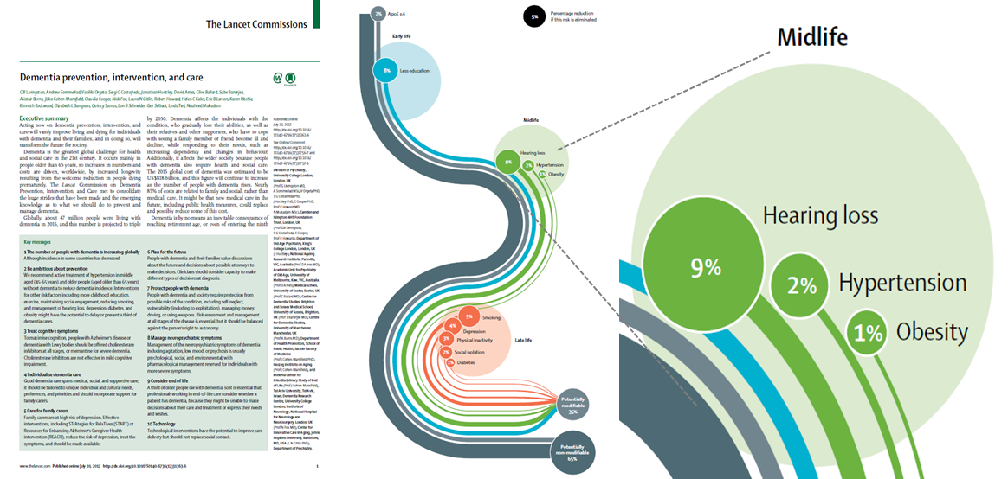
Hearing loss and dementia
Evidence has indicated that the risk of dementia and Alzheimer’s disease increases with hearing loss severity¹
In 2017, findings from a commission on dementia prevention, intervention and care stated that hearing loss is the single largest modifiable risk factor for dementia²
Dementia incidence could be reduced with the treatment of hearing loss²
1. Lin FR et al. Arch Neurol 2011;68(2):214–20 2. Livingston G et al. Lancet 2017;390(10113):2673–734

Slide 7
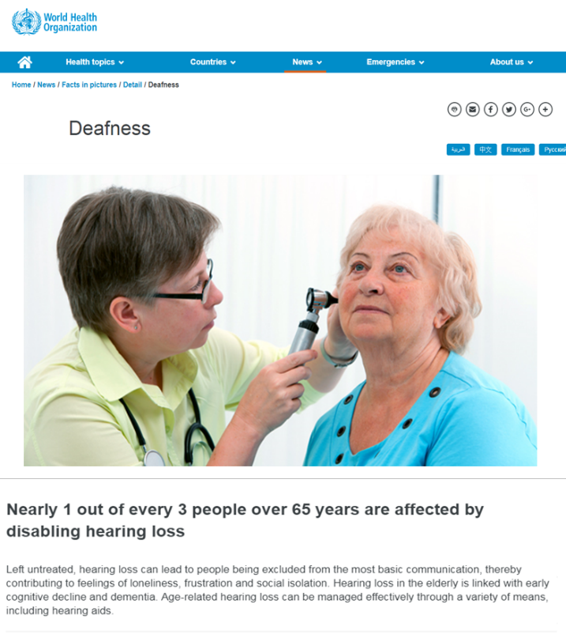

Cochlear implant use in adults
Cochlear implantation has now been available for more than 30 years in many countries
Cochlear implants (CIs) are the standard of care for newborns with severe to profound sensorineural hearing loss (SNHL) in many developed countries
  In children, penetration of CIs is high
In adults, cochlear implantation is often only considered when there is no benefit from hearing aids
  Many adults who could benefit from CIs do not receive them
  As in children, CI use in adults has potential to become the standard of care
1. World Health Organization. Deafness and hearing loss. Available from: https://www.who.int/news-room/fact-sheets/detail/deafness-and-hearing-loss (Accessed July 2019)
CI, cochlear implant; SNHL, sensorineural hearing loss

Slide 8
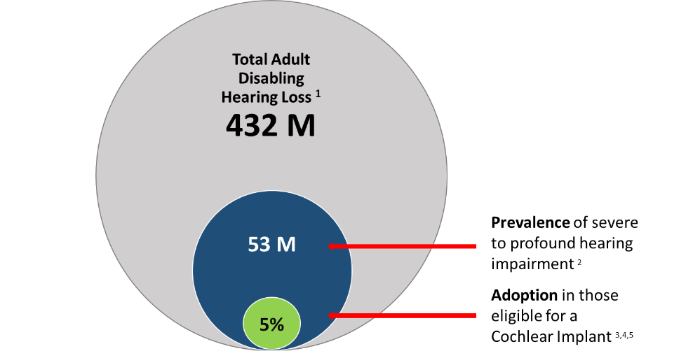
What do we know?
Benefits have been demonstrated but adoption is low
Adults using CIs experience improvements compared with hearing aid only or no treatment, in terms of:
  speech perception^{6,7}
  educational⁸ and employment⁹ opportunities
  quality of life^{6,10}
CIs have been shown to be cost effective¹¹
However, penetration of CIs in eligible adults is as low as 5%
Global adult hearing loss (2018)
*Eligibility for CIs varies according to country-specific guidelines
1. World Health Organization. Deafness and hearing loss. Available from: https://www.who.int/news-room/fact-sheets/detail/deafness-and-hearing-loss (Accessed June 2019); 2. Global Burden of Disease Hearing Loss Expert Group. Eur J Public Health 2013;23:146–52; 3. Sorkin D. Cochlear Implants Int 2013;14(Suppl 1):S1; 4. De Raeve L. Eur Ann Otorhinolaryngol Head Neck Dis 2016;133(Suppl 1):S57–60; 5. Raine C. Cochlear Implants Int 2013;14(Suppl 1):S32–7; 6. Lenarz T et al. Audiol Neurootol 2017;22:61–73; 7. Bassim MK et al. Laryngoscope 2005;115:1568–73; 8. Shield B. Evaluation of the social and economic costs of hearing impairment. A report for Hear-it. 2006. Available from: https://www.hear-it.org/sites/default/files/multimedia/documents/Hear_It_Report_October_2006.pdf (Accessed June 2019); 9. Woodcock K, Pole JD. Int J Rehabil Res 2008;31:297–304; 10. Sanchez-Cuadrado I et al. Ann Otol Rhinol Laryngol 2013;122:222–8; 11. Bond M et al. Health Technol Assess 2009;13:1–330
CI, cochlear implant; M, millions

Slide 9
Defining standard of care
9

Slide 10
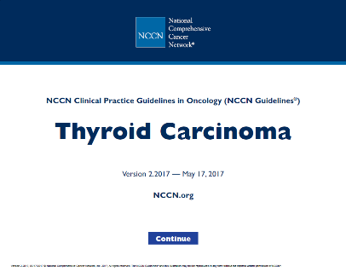


What does standard of care mean?
Clinical practice guidelines are often the foundation of standard of care practices
From a medical perspective, standard of care describes which treatment is appropriate, based on scientific evidence and collaboration between professionals
  It is typically the process a clinician should follow for a certain type of patient, illness or clinical circumstance
From a legal perspective, standard of care is the degree of prudence and caution required of an individual who is under a duty of care
Thyroid cancer
Ear, nose and throat
Antibiotics

Slide 11

What does standard of care mean for the patient?
From the patient’s perspective, achieving standard of care can lead to:
  More consistent medical diagnosis, referral and treatment guidelines
  Better access to CI treatment and aftercare
  Improvements in quality of life and health, through optimizing hearing function, social participation and engagement
The standard of care will also raise awareness, making the care pathway more transparent and educating a wider audience about the effectiveness of CI treatment
CI, cochlear implant

Slide 12
Consensus to achieve standard of care in CI treatment for adults
Comparative data
Body of evidence
Consistent opinions
Standard of care
Risks versus benefit across:
treatment options
patient populations
affected groups
and over time
Consensus at all levels, especially local level, among:
clinical experts
specialty societies
patient advocacy groups
political channels
administrative arm of government
Notes:
Linking international consensus with local level opinions may be achieved with targeted dissemination to congresses, meetings, local organizations (see more about promotion on slide 22 [CAPAC])

Slide 13
13

Slide 14

What is a Delphi consensus process?
An established consensus-based technique that allows for the collection and aggregation of informed judgements from a group of experts
  Uses several rounds of questionnaires to seek anonymous responses, which are then aggregated
  Seeks to reach the correct response through consensus
  The result is a series of consensus statements about a clinical area that have been agreed on by experts in the field

Slide 15

Clinical practice guidelines
Fully endorsed by key organizations
  ... include recommendations intended to optimize patient care that are informed by a systematic review of evidence and an assessment of the benefits and harms of alternative care options¹
1. American Academy of Otolaryngology – Head and Neck Surgery. Clinical practice guidelines. Available from: https://www.entnet.org/content/clinical-practice-guidelines (Accessed June 2019)

Slide 16

Consensus statements
A summary of available evidence and expert opinion
  … opinions synthesized from a group of experts into a written document
  … reflect the expert views of a panel of individuals who are well versed on the topic of interest while carefully examining and discussing the scientific data available¹
1. American Academy of Otolaryngology – Head and Neck Surgery. Clinical consensus statements. 2019. Available from: https://www.entnet.org/content/clinical-consensus-statements (Accessed June 2019)

Slide 17

Consensus statements and clinical practice guidelines
Consensus statements should provide a stepping stone towards establishing clear, consistent, international clinical guidelines and best practice for patients

Slide 18

Delphi consensus process and achieving standard of care
The Delphi consensus process outcomes will provide a summary of clinical evidence and expert opinion on cochlear implantation in adults
Findings from the Delphi process have the potential to:
  help establish CIs as the standard of care for adults with severe to profound SNHL
  raise awareness of CI as a treatment option and when it should be considered
  achieve appropriate improved access to CIs for patients who would benefit
  help optimize patient pathways, leading to treatment that improves the individual’s hearing function and quality of life
CI, cochlear implant; SNHL, sensorineural hearing loss

Slide 19

Overview of the cochlear implant Delphi process
1. Recruit steering committee and panel and design the process
2. Conduct literature searches and draft report
3. Draft up to
25 consensus statements, reflecting the available evidence
4. Obtain input via three rounds of Delphi voting and steering committee
5. Create peer-reviewed publication of consensus statements and submit
The process has been facilitated by Oxford PharmaGenesis (https://www.pharmagenesis.com), an independent HealthScience communications consultancy providing services to the healthcare industry, professional societies and patient groups through specialist practices
Notes:
Design: A steering committee and panel of international medical experts was formed to design and advise on the process to agree on a standard of care in adults with severe to profound sensorineural hearing loss.
Review: A systematic literature review was conducted, including awareness of cochlear implantation, diagnosis pathways, surgery, rehabilitation, performance and outcomes, and cost implications.
International Consensus Statement: The steering committee and panel members participated in a three-round Delphi voting process to agree on appropriate consensus statements for best practice.
Focus on the User: A Consumer & Professional Advocacy Committee (CAPAC) is providing input based on user-experience and dissemination of best practice.
Publish: The international consensus paper is being drafted to provide a step towards establishing clear, consistent, international clinical guidelines and best practice aftercare for cochlear implant patients, so they can reach their optimal hearing outcome and attain the best quality of life. The planned international consensus paper is focused on SPSNHL in adults and unilateral implantation.
The 6th step is to EDUCATE: A long-term communications strategy is being developed to support awareness and education of best-practice.
Literature Review
English only
Hearing Loss terms in the title or Abstract
He has been engaged by Oxford PharmaGenesis to provide a further level of independence and rigour to the Consensus process.

Slide 20


Steering committee
An independent steering committee was formed to manage the consensus process
The steering committee was responsible for finalizing the Delphi consensus protocol
The steering committee was chaired by Dr Craig Buchman (Washington University School of Medicine, USA) and consisted of four members:
  Professor René Gifford (Vanderbilt University, Nashville, USA)
  Dr David Haynes (Vanderbilt University, Nashville, USA)
  Professor Thomas Lenarz (Medical University of Hannover, Germany)
  Professor Gerard O’Donoghue (University of Nottingham, UK)
Dr Craig Buchman

Slide 21
Delphi panel
A Delphi panel was formed to take part in the consensus process
The role of the panel members was to review the draft consensus statements and supporting evidence and take part in the voting of the Delphi consensus process
The Delphi panel was composed of clinical experts in the field of cochlear implantation
  The panel included all four members of the steering committee
Additional candidates for the Delphi panel were identified by the steering committee and were approved by the Chair and steering committee

Slide 22


Geographic spread of Delphi panel members
The Delphi panel and steering committee bring together clinical experts, ear nose and throat specialists and audiologists from around the globe
Chair
30 Delphi panel members
13 countries represented

Slide 23

Panel: global experience across audiology and cochlear implantation
*Note, these panel members shared a voting role so are counted as only one voting member

Slide 24
Advocacy is key to real-world acceptance:
Consumer and Professional Advocacy Committee (CAPAC)
Knowledge alone is not enough to achieve acceptance and adoption of the consensus statements: promotion and advocacy will be important
The perspectives of people with hearing loss must be taken into account
To fulfil these needs, the CAPAC was formed
The CAPAC aims to promote the knowledge, dissemination, acceptance and adoption of consensus statements among consumer advocacy organizations and healthcare providers and their professional organizations
CAPAC members were given the opportunity to comment on consensus statements and make suggestions at each round, but did not take part in the voting of the Delphi process
24

Slide 25








Consumer and Professional Advocacy Committee (CAPAC)
Ms Barbara Kelley (co-Chair) Executive Director of Hearing Loss Association of America (HLAA)
Dr Harald Seidler (co-Chair) CI User, representative of the International Federation of Hard of Hearing People and immediate past President of the German Association of the Hard of Hearing (1996- 2019)
Dr Leo De Raeve European Association of Cochlear Implant Users (EURO-CIU)
Professor Bernard Fraysse International Federation of Otorhino Laryngological Societies (IFOS)
Ms Darja Pajk European Federation of Hard of Hearing People (EFHOH) and CI user
Ms Donna Sorkin American Cochlear Implant (ACI) Alliance and CI user
Professor George Tavartkiladze International Society of Audiology (ISA)
CI, cochlear implant

Slide 26
Levels of evidence
Uncontrolled studies/ monographs
Observational case studies
Expert opinion, testimonials
Small RCT
Large RCT
Systematic reviews
Increased quality of clinical evidence

Slide 27
Literature review to inform statements
A systematic literature review was conducted to obtain evidence relevant to adults with bilateral severe, profound, or moderate sloping to profound sensorineural hearing loss, and unilateral CIs
Searches were conducted in MEDLINE, Embase and Cochrane Library on July 18, 2018
Review
Scope
Evidence
English language publications from 2005 onward
Australia, Canada, China, Europe, India, Japan, UK and USA
Best practice guidelines
for rehabilitation
Clinical effectiveness
of CI
Factors that impact
CI performance
Best practice
for diagnosis
Level of awareness
of CI
Best practice
guidelines for surgery
Cost implications
of CI
Identified studies were screened
for relevance
Included studies were quality-assessed using a recognized method (Eubank et al. 2016)¹
1. Eubank BH et al. BMC Med Res Methodol 2016;16:56
CI, cochlear implant; Embase, Excerpta Medica Database; MEDLINE, Medical Literature Analysis and Retrieval System Online
Notes:
Exclusions from the literature review:
Studies with sample size less than 20
Case studies, case series and narrative reviews
Studies published before 2005
Pediatric populations
Studies of hearing preservation
Bilateral cochlear implants
Electro-acoustic stimulation or hybrid hearing

Slide 28
Delphi voting process
Using the findings of the literature review, 21 consensus statements were drafted
These statements, and all supporting evidence from the literature (including quality assessment), were presented to the panel during three anonymous voting rounds
At each voting round, the panel marked their level of agreement/disagreement with each statement, using a 6-point Likert scale
Voting round 1: online questionnaire
Voting round 2: online questionnaire
Voting round 3: face-to-face meeting

Slide 29
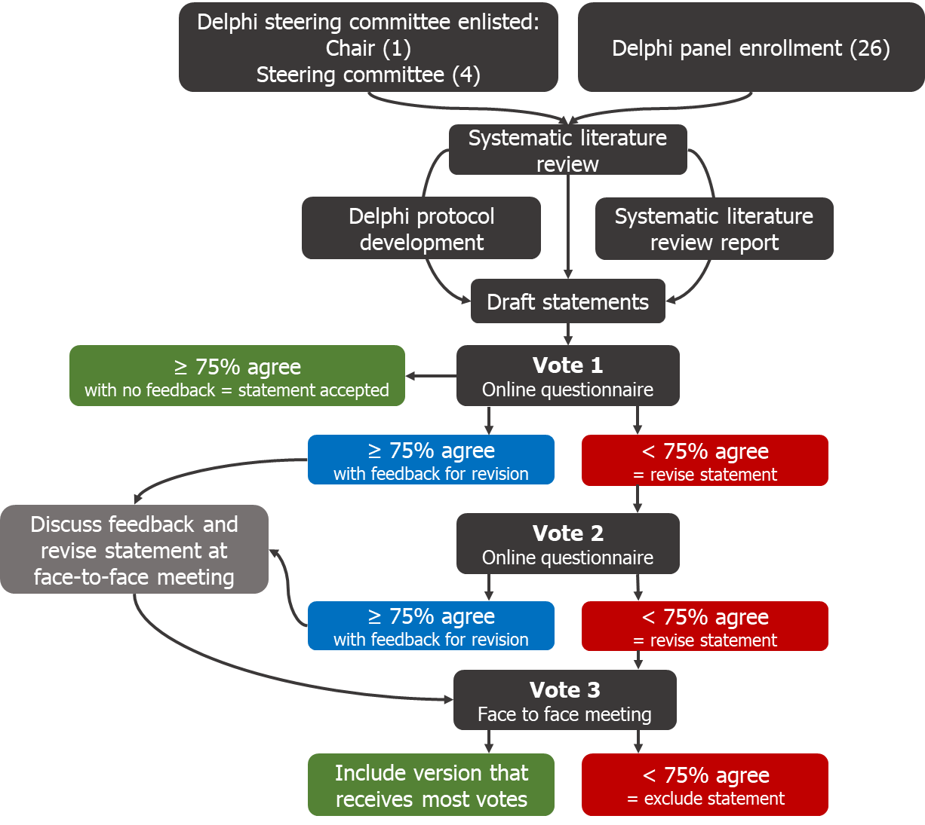
Delphi voting process
The action for each statement for the subsequent round was determined by:
  the 75% agreement threshold, and/or
  provision of feedback from the panel members
A statement which reached the agreement threshold could still be revised if feedback was able to improve the statement
Following voting round 3, statements that reached at least 75% consensus were included in the final published statements

Slide 30
Next steps
30

Slide 31
What will the Consensus Statements lead to?
They mark the first step in raising awareness of the benefits of cochlear implantation in adults and in improving how potential CI candidates are identified and treated.
The ultimate goal is to improve hearing and QoL in adults with SNHL who are eligible for unilateral cochlear implantation.

Slide 32

Maximizing the impact of the Delphi process
An international consensus paper will be submitted to a high-impact journal
Following publication, the real work begins for all of us!
Dissemination and promotion is key to help the statements influence awareness and referral behavior
Engagement of professionals and community
Adoption of clinical practice guidelines
Development of country-specific clinical practice guidelines through national medical academies
Policy advocacy to positively influence decision-making for payers and policy makers

Slide 33
Working together towards the same goal
Manufacturers
Payers
CAPAC
Hearing loss organizations
CI users
Clinicians
Greater access to CIs and better quality of life
CAPAC, Consumer and Professional Advocacy Committee; CI, cochlear implant

Slide 34
STANDARD OF CARE
For adults with severe to profound
sensorineural hearing loss
Unilateral Cochlear Implants for Bilateral Severe, Profound, or Moderate Sloping to Profound Sensorineural Hearing Loss
Consensus for cochlear implantation
INSERT INSTITUTION LOGO HERE
INSERT DATE HERE
34

Slide 35
Consensus Statement Categories
Level of awareness of CIs
Best practice clinical pathway for Diagnosis
Best practice guidelines for surgery
Clinical effectiveness of CIs
Factors associated with post-implantation outcomes
The relationship between hearing loss and depression, cognition, and dementia
Cost implications of CIs

Slide 36
Level of awareness of CIs

Slide 37

Consensus Statement
Level of awareness of CIs
Awareness of cochlear implants among primary and hearing healthcare providers is inadequate, leading to under-identification of eligible candidates. Clearer referral and candidacy pathways would help increase access to cochlear implants.
Delphi Consensus Group on Cochlear Implantation in Adults

Slide 38
Best practice clinical pathway for diagnosis

Slide 39
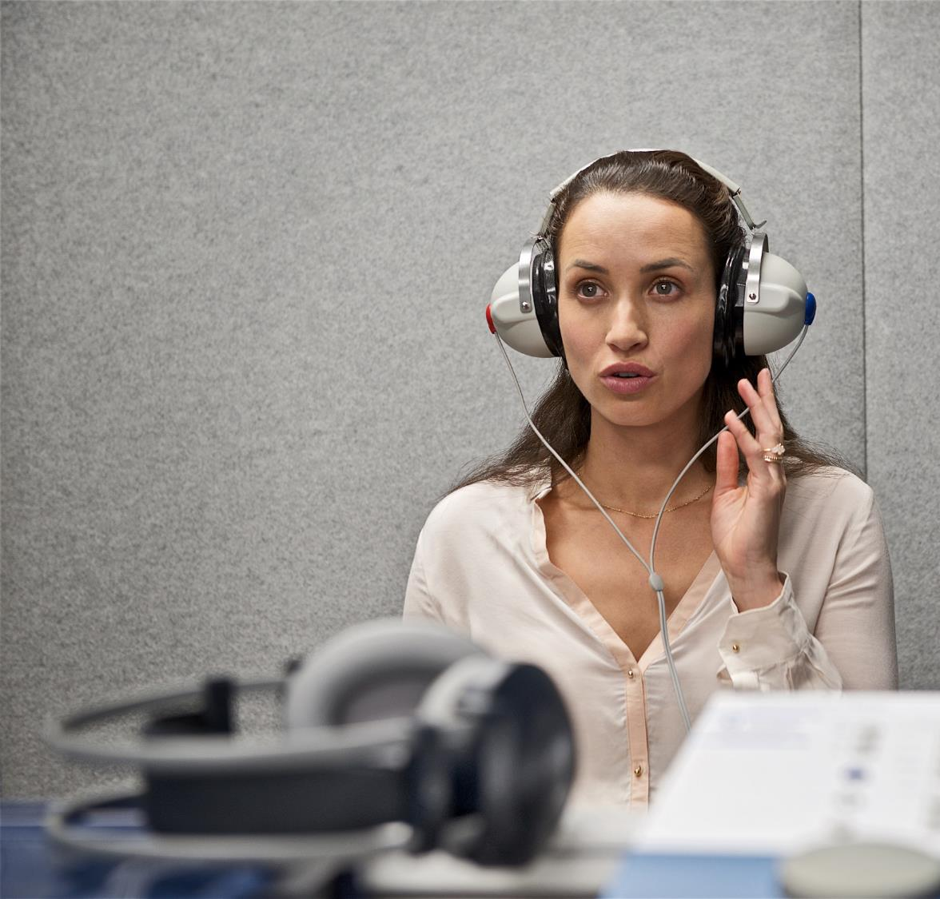
Consensus Statements
Detection of hearing loss in adults is important; pure tone audiometry screening methods are considered the most effective.
The addition of a questionnaire or interview to the screening can improve the detection of sensorineural hearing loss.¹
¹Delphi Consensus Group on Cochlear Implantation in Adults;

Slide 40

Consensus Statements
Preferred aided speech recognition tests for cochlear implant candidacy in adults include monosyllabic word tests and sentence tests, conducted in quiet and noise.
Further standardisation of speech recognition tests is needed to facilitate comparison of outcomes across studies and countries.¹
¹Delphi Consensus Group on Cochlear Implantation in Adults;

Slide 41

Consensus Statements
Age alone should not be a limiting factor to cochlear implant candidacy, as positive speech recognition and quality of life outcomes are experienced by older adults as well as younger adults.¹
¹Delphi Consensus Group on Cochlear Implantation in Adults;

Slide 42
Best practice guidelines
for surgery

Slide 43
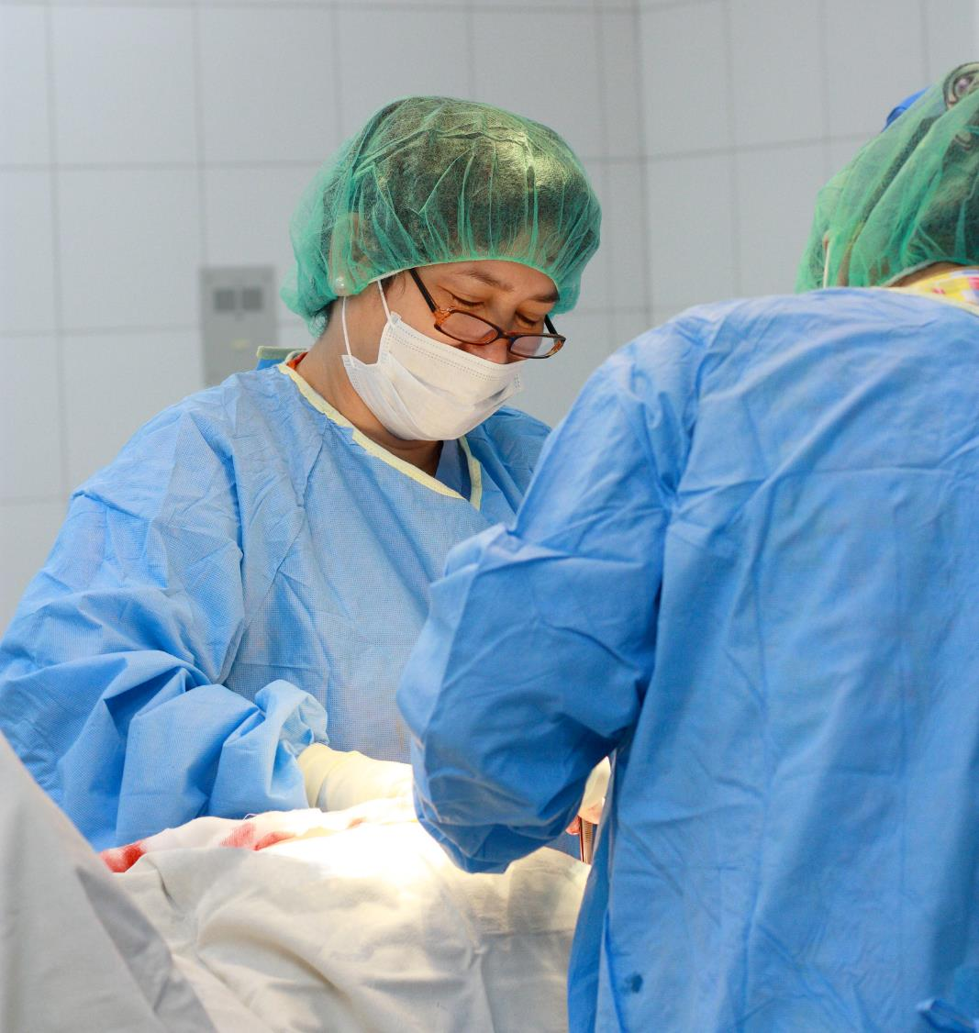
Consensus Statements
Both curved (perimodiolar) and straight electrodes are clinically effective for cochlear implantation, with a low rate of complications.
When possible, hearing preservation surgery can be beneficial in individuals with substantial residual hearing.¹
¹Delphi Consensus Group on Cochlear Implantation in Adults;

Slide 44
Clinical effectiveness of cochlear implants

Slide 45

Consensus Statements
Cochlear implants significantly improve speech recognition in both quiet and moderate noise in adults with bilateral severe, profound, or moderate sloping to profound sensorineural hearing loss; these gains in speech recognition are likely to remain stable over time¹
Both word and sentence recognition tests should be used to evaluate speech recognition performance following cochlear implantation¹
¹Delphi Consensus Group on Cochlear Implantation in Adults

Slide 46

Consensus Statements
Cochlear implants significantly improve overall and hearing-specific quality of life in adults with bilateral severe, profound, or moderate sloping to profound sensorineural hearing loss¹
Adults who are eligible for cochlear implants should receive the implant as soon as possible to maximize post-implantation speech recognition¹
¹Delphi Consensus Group on Cochlear Implantation in Adults

Slide 47
Factors associated with post-implantation outcomes

Slide 48

Consensus Statements
Where appropriate, individuals should use hearing aids with their cochlear implant in order to achieve bilateral benefits and the best possible speech recognition and quality of life outcomes.¹
Many factors impact cochlear implant outcomes; further research is needed to understand the magnitude of the effects.¹
¹Delphi Consensus Group on Cochlear Implantation in Adults

Slide 49
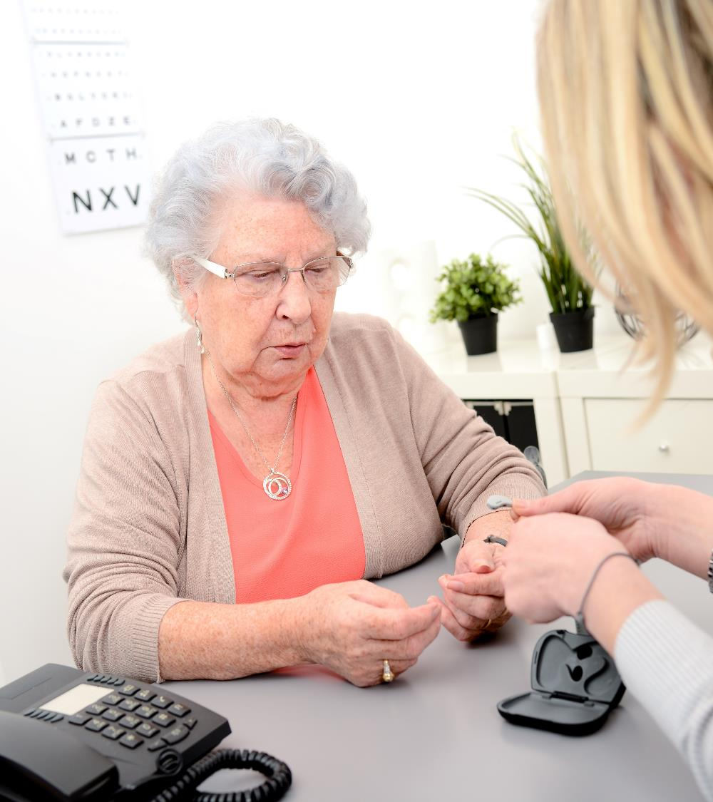
Consensus Statements
Long durations of unaided hearing loss do not rule out potential benefit of cochlear implants: individuals who receive an implant in an ear that was previously unaided for more than 15 years have been shown to experience improvements in speech recognition.¹
Adults who have undergone cochlear implantation should receive programming sessions, as needed, to optimize outcomes.¹
¹Delphi Consensus Group on Cochlear Implantation in Adults

Slide 50
The relationship between hearing loss
and depression, cognition, and dementia

Slide 51

Consensus Statements
15. Adults with hearing loss can be substantially affected by social isolation, loneliness, and depression; evidence suggests that treatment with cochlear implants can lead to improvement in these aspects of well-being and mental health. Longitudinal studies are needed to obtain further knowledge in this area.¹
16. There is an association between age-related hearing loss and cognitive/memory impairment.¹
¹Delphi Consensus Group on Cochlear Implantation in Adults

Slide 52

Consensus Statements
17. Further research is required to confirm the nature of cognitive impairment in individuals with hearing loss, and its potential reversibility with treatment.¹
18. The use of cochlear implants may improve cognition in older adults with bilateral severe to profound sensorineural hearing loss.¹
19. Hearing loss is not a symptom of dementia; however, treatment of hearing loss may reduce the risk of dementia. ¹
¹Delphi Consensus Group on Cochlear Implantation in Adults

Slide 53
Cost implications of
cochlear implants

Slide 54

Consensus Statement
20. Unilateral cochlear implantation in adults is cost-effective when compared with no implant or no intervention at all and is associated with increased employment and income.¹
¹Delphi Consensus Group on Cochlear Implantation in Adults.

