Slide 1
STANDARD OF CARE
Systematic review and consensus: unilateral cochlear implants for bilateral severe, profound, or moderate sloping to profound sensorineural hearing loss¹
Consensus statements for cochlear implantation
Category 3 - Best practice guidelines for surgery
¹Delphi Consensus Group on Cochlear Implantation in Adults; Craig A Buchman, René H Gifford, David Haynes, Thomas Lenarz,
Gerard O’Donoghue, Oliver Adunka, Alison L Baird, Allison Biever, Robert Briggs, Matthew L Carlson, Oliver Cole, Charlotte L Cookson, Pu Dai,
Colin Driscoll, Howard W Francis, Bruce Gantz, Richard K Gurgel, Marlan Hansen, Meredith Holcomb, Rebecca J Hornby, Eva Karltorp,
Milind Kirtane, Jannine Larky, Lisa M Law,⁷ Emmanuel Mylanus, J Thomas Roland Jr, Shakeel R Saeed, Henryk Skarzynski, Piotr H Skarzynski,
Mark Syms, Holly Teagle, Paul Van de Heyning, Christophe Vincent, Hao Wu, Tatsuya Yamasoba, Terry Zwolan.

Slide 2
Consensus Statement Categories
Level of awareness of CIs
Best practice clinical pathway for diagnosis
Best practice guidelines for surgery
Clinical effectiveness of CIs
Factors associated with post-implantation outcomes
The relationship between hearing loss and depression, cognition, and dementia
Cost implications of CIs

Slide 3
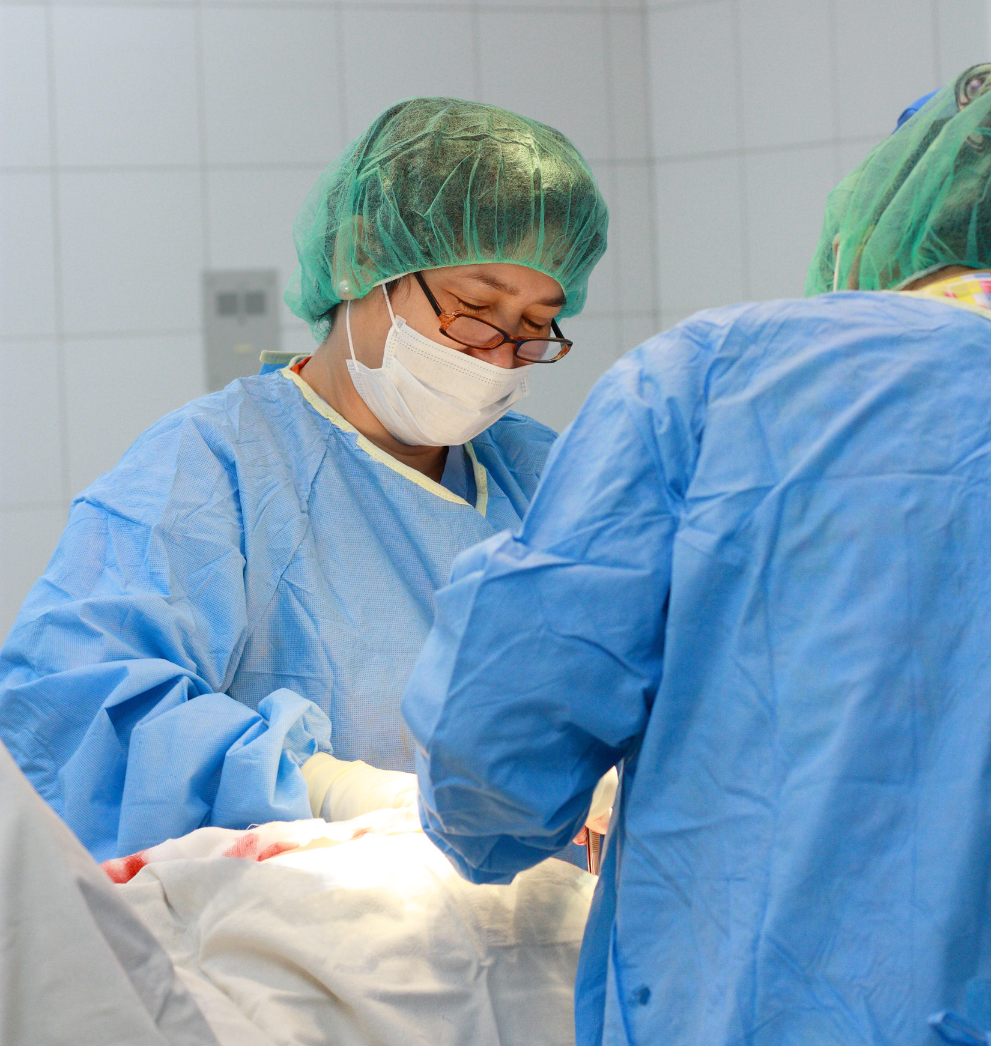
Consensus Statements
Both curved (perimodiolar) and straight electrodes are clinically effective for cochlear implantation, with a low rate of complications. ¹
When possible, hearing preservation surgery can be beneficial in individuals with substantial residual hearing.¹
¹Delphi Consensus Group on Cochlear Implantation in Adults;

Slide 4
Findings What did the systematic literature review tell us?

Slide 5
Statement 5: Curved (perimodiolar) and straight electrodes are clinically effective for cochlear implantation, with a low rate of complications.
Several studies identified in adults ^{46, 50, 53-60}
Both types of electrodes are widely used
After surgery, hearing preservation rates vary for both straight lateral wall and perimodiolar electrodes groups^{53, 56, 59, 60}
One study reported no difference in speech recognition scores for individuals receiving straight, lateral wall electrodes versus those with pre-curved perimodiolar electrodes⁵⁴
Selection of the electrode type should be made on an individual basis by the CI surgeon

Slide 6
SUPPORTING EVIDENCE What was the evidence that contributed to the statement?

Slide 7
Supporting Evidence: Castiglione et al 2015
Objective: To analyse outcomes and complications of unilateral CIs in hearing impaired elderly patients.
Methods: Retrospective, single-centre observational study.
N=30 older adults, aged 65 -79 yrs, implanted over a 4-year period.
Review of clinic files of surgical outcomes and audiological tests.
⁵⁵ Castiglione A, Benatti A, Girasoli L, Caserta E, Montino S, Pagliaro M, et al. Cochlear implantation outcomes in older adults. Hearing Balance Comm 2015; 13: 86–8.

Slide 8
Supporting Evidence: Castiglione et al 2015
Results:
No adverse surgical events or major complications were observed.
Temporary issues, spontaneously recovered a few days post surgery
No correlation between complications and pre-operative comorbidities.
Conclusion:
Significant benefits for speech recognition and aided hearing levels are achieved.
Type and rate of complications observed for this older CI-group are similar to those published for younger CI-users.
CI is considered a safe and effective treatment of significant hearing loss in older adults.
⁵⁵ Castiglione A, Benatti A, Girasoli L, Caserta E, Montino S, Pagliaro M, et al. Cochlear implantation outcomes in older adults. Hearing Balance Comm 2015; 13: 86–8.
Notes:
Results: No surgical events and no major complications were observed.
Temporary issues, spontaneously recovered a few days post surgery
E.g. dizziness in six patients (20%) , facial palsy in one patient (3%).
No correlation between complications and pre-operative comorbidities.
Conclusion:
Significant benefits for speech recognition and aided hearing thresholds for the group.
Type and rate of complications observed for older CI-recipients in this study are similar to those reported in the literature for younger CI-recipients.
CI should be considered a safe and effective treatment of significant hearing loss in older adults. person

Slide 9
Supporting Evidence: Roberts et al 2013
Objective: To analyse and compare outcomes from CIs in older adults compared to younger adults.
To examine and understand the reasons behind any differences in the two age groups.
Methods: Retrospective, single centre observational study. N=113 adults implanted over a 4-yr period, n=46, <65 years and n=67, >65yrs.
Surgical records and demographic data examined.
Monosyllabic words scores in quiet at 65dBHL at preimplant and post implant intervals.
⁵⁰ Roberts DS, Lin HW, Herrmann BS, Lee DJ. Differential cochlear implant outcomes in older adults. Laryngoscope 2013;

Slide 10
Supporting Evidence: Roberts et al 2013
Results:
Both older and younger groups demonstrated improved speech recognition post implant
Younger adults have significantly better absolute speech recognition scores than older adults
Adults > 80yrs had the poorest speech scores, BUT still showed significant improvement
Family history of hearing loss was observed more often in younger adults
No differences in post-op vestibular symptoms or surgical complications between the two age groups were observed
⁵⁰ Roberts DS, Lin HW, Herrmann BS, Lee DJ. Differential cochlear implant outcomes in older adults. Laryngoscope 2013;

Slide 11
Supporting Evidence: Roberts et al 2013
Conclusion:
Older and younger CI recipients demonstrate significant benefits post implant and no differences in complications or surgical events
This is important for consideration in counselling of the hearing impaired adult when considering cochlear implantation
⁵⁰ Roberts DS, Lin HW, Herrmann BS, Lee DJ. Differential cochlear implant outcomes in older adults. Laryngoscope 2013;

Slide 12
Findings What did the systematic literature review tell us?

Slide 13
Statement 6: When possible, hearing preservation surgery can be beneficial in individuals with substantial residual hearing.
In adults with residual hearing, hearing preservation is an important goal of surgery when considering the best possible outcomes
The CI-user with preserved residual hearing may be able to use and benefit from combined electric and acoustic hearing stimulation
Between 22–77% of CI-adults showed preserved residual hearing preservation for the low-frequencies, measured at 4–33 months post surgery^{53, 56, 59-61}
Differences in evaluation and reporting methods, and CI-user profiles may account for some of the variability reported

Slide 14
SUPPORTING EVIDENCE What was the evidence that contributed to the statement?

Slide 15
Supporting Evidence: Ramos-Macias et al 2017
Objective: To investigate the effects of surgical approach and electrode design on preservation of residual hearing in low frequencies during and after intracochlear insertion.
Electrode types included:
recent sheath-based perimodiolar array (A)
a stylet based perimodiolar array (B)
and a straight lateral wall array (C )
Method: Prospective, single site, single subject repeated measures study. N= 26 hearing impaired adults, 3 subgroups 10-A, 9-B, 7-C. Electrode design was randomly assigned for each adult. Outcomes compared between groups.
Measures included at preimplant and postimplant at 3, 6 and 12 months:
Pure tone thresholds
Speech recognition scores for Spanish Bisyllabic words in quiet at 65dBHL
⁵³ Ramos-Macías A, Borkoski-Barreiro SA, Falcón-González JC, Ramos-de Miguel A. Hearing preservation: a preliminary experience. Audiol Neurootol 2017

Slide 16
Supporting Evidence: Ramos-Macias et al 2017
Definition: Preserved hearing defined as changes in low frequency thresholds at postimplant from preimplant
Results: At 12 months:
74-83% of adults had significant improvements in word recognition mean correct scores,
No significant difference between subgroups
62% of adults with residual hearing had preserved low frequency hearing
No significant differences between subgroups, or surgical approaches
Trend towards superior preservation for round window approach and for flexible array designs
<15 dB
Conclusions: Long term hearing preservation up to 12 months post implant was demonstrated.
Further research with longer term follow-up is needed to assess the influence upon outcomes.
⁵³ Ramos-Macías A, Borkoski-Barreiro SA, Falcón-González JC, Ramos-de Miguel A. Hearing preservation: a preliminary experience. Audiol Neurootol 2017

Slide 17
Supporting Evidence: Helbig et al 2011
Objective:
To determine the extent of hearing preservation retrospectively after atraumatic CI surgery using a specialized surgical technique and a flexible electrode designed to minimize cochlear trauma.
Method:
Retrospective, single arm, repeated measures study in an academic tertiary centre. N=34 adults between 33 and 86 years.
Measures included at preimplant and 6 months:
Pure tone thresholds
Speech recognition scores for German monosyllabic words at 65 dBSPL
⁶⁰ Helbig S, Helbig M, Leinung M, Stover T, Baumann U, Rader T. Hearing preservation and improved speech perception with a flexible 28-mm electrode. Otol Neurotol 2015

Slide 18
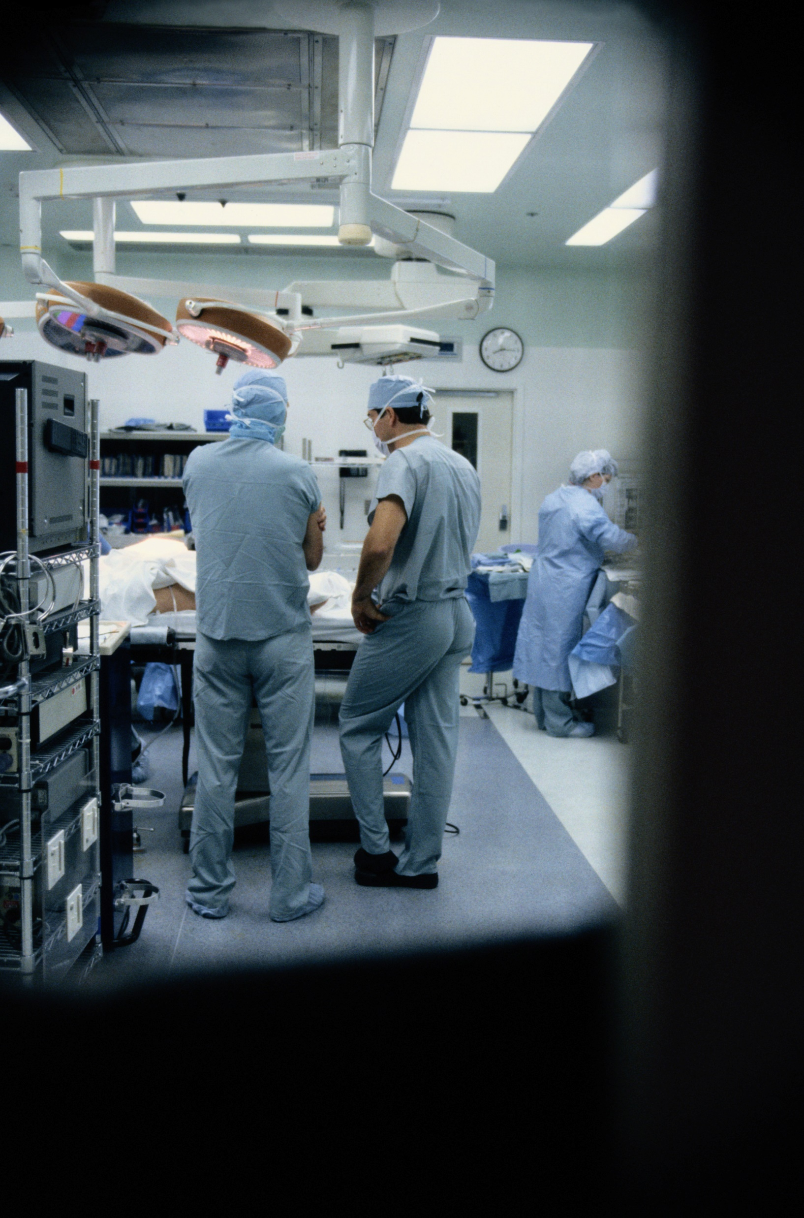
Supporting Evidence: Helbig et al 2011
Definition: Preserved hearing defined as changes in low and high frequency thresholds at postimplant from preimplant < 20 dB
Results: at 6 months:
41% of adults showed hearing preservation of low frequencies
36% of adults showed hearing preservation of low frequencies
Group median speech recognition scores significantly improved to 60%
Conclusion: Appropriate surgical techniques and flexible electrodes, designed to minimize cochlear trauma, may enable hearing preservation.
Hearing preservation may further benefit postimplant speech recognition outcomes.
⁶⁰ Helbig S, Helbig M, Leinung M, Stover T, Baumann U, Rader T. Hearing preservation and improved speech perception with a flexible 28-mm electrode. Otol Neurotol 2015

Slide 19
Conclusion & Takeaways
CI-surgery is a safe and well established routine clinical procedure also for adults of all ages
On average, adults of all ages show significant benefits for speech recognition (understanding) compared to their preimplant hearing condition
The preservation of residual hearing is important and possible across the frequency range and may enable better hearing outcomes
The surgical approach and electrode choice can influence hearing preservation
Preserved hearing may enable the use of combined electrical and acoustic stimulation to enable better hearing outcomes
¹Delphi Consensus Group on Cochlear Implantation in Adults

Slide 20
Bibliography
⁴⁶ Chen SY, Grisel JJ, Lam A, Golub JS. Assessing cochlear implant outcomes in older adults using HERMES: a national web-based database. Otol Neurotol 2017;
⁵⁰ Roberts DS, Lin HW, Herrmann BS, Lee DJ. Differential cochlear implant outcomes in older adults. Laryngoscope 2013;
⁵³ Ramos-Macías A, Borkoski-Barreiro SA, Falcón-González JC, Ramos-de Miguel A. Hearing preservation with the Slim Modiolar Electrode Nucleus CI532® cochlear implant: a preliminary experience. Audiol Neurootol 2017;
⁵⁴ van der Jagt MA, Briaire JJ, Verbist BM, Frijns JH. Comparison of the HiFocus Mid-Scala and HiFocus 1J electrode array: angular insertion depths and speech perception outcomes. Audiol Neurootol 2016; 21:
⁵⁵ Castiglione A, Benatti A, Girasoli L, Caserta E, Montino S, Pagliaro M, et al. Cochlear implantation outcomes in older adults. Hearing Balance Comm 2015; 13: 86–8.
⁵⁶ Jurawitz MC, Büchner A, Harpel T, Schussler M, Majdani O, Lesinski-Schiedat A, et al. Hearing preservation outcomes with different cochlear implant electrodes: Nucleus® Hybrid™-L24 and Nucleus Freedom™ CI422. Audiol Neurootol 2014;
⁵⁷ Tang L, Thompson CB, Clark JH, Ceh KM, Yeagle JD, Francis HW. Rehabilitation and psychosocial determinants of cochlear implant outcomes in older adults. Ear Hear 2017;
⁵⁸ Batuecas-Caletrio A, Klumpp M, Santacruz-Ruiz S, Benito Gonzalez F, Gonzalez Sanchez E, Arriaga M. Vestibular function in cochlear implantation: correlating objectiveness and subjectiveness. Laryngoscope 2015;
⁵⁹ Mick P, Amodi H, Shipp D, Lin V, Nedzelski J, Chen J. Hearing preservation after adult cochlear implantation using the FLEXsoft electrode. Laryngoscope 2011; ⁶⁰ Helbig S, Helbig M, Leinung M, Stover T, Baumann U, Rader T. Hearing preservation and improved speech perception with a flexible 28-mm electrode. Otol Neurotol 2015;
^{60.}Helbig S, Helbig M, Leinung M, Stover T, Baumann U, Rader T. Hearing preservation and improved speech perception with a flexible 28-mm electrode. Otol Neurotol 2015; 36: 34–42.
⁶¹ Helbig S, Baumann U, Hey C, Helbig M. Hearing preservation after complete cochlear coverage in cochlear implantation with the free-fitting FLEXSOFT electrode carrier. Otol Neurotol 2011;

